Slide 1

CSPM 504 INDEPENDENT STUDY 1/TERM PAPER 1
Transformer-Based Feature Fusion Approach
for Multimodal Visual Sentiment Recognition
Using Tweets in the Wild
NATIONAL INSITUTE OF TECHNOLOGY DELHI
SHIVAM SINGH
M.Tech (CSA)
Roll No : 242211017
Supervisor
Prof. (Dr.) Geeta Sikka

Slide 2
Slide 3
Content
Introduction
Problem Statement
Proposed work
Literature Review
Dataset
Methodology
Conclusion
Reference
NATIONAL INSITUTE OF TECHNOLOGY DELHI

Slide 3
Slide 3
Introduction
The paper "Transformer-Based Feature Fusion Approach for Multimodal Visual Sentiment Recognition Using Tweets in the Wild“[1] introduces a framework aimed at improving sentiment analysis using multimodal data from online social networks (OSNs).
Vision Transformers (ViTs) and BERT to extract features from images with faces, text, and generic visuals.
Model addresses data imbalance and enhances performance, enabling robust multimodal sentiment analysis across different domains​
NATIONAL INSITUTE OF TECHNOLOGY DELHI

Slide 4
Slide 3
Problem Statement
Social media platforms have become a primary source for users to express their thoughts, emotions, and opinions, often through a combination of text and images. However, this unstructured and diverse content presents significant challenges for sentiment analysis. Traditional sentiment analysis techniques focus predominantly on textual data, neglecting the critical emotional cues embedded in visual content. This limitation hinders the ability to accurately capture the full spectrum of user sentiment. Moreover, sentiment datasets derived from social media often suffer from class imbalance, which impacts the performance and generalization of classification models. While Convolutional Neural Networks (CNNs) have been widely used for image-based sentiment analysis, they struggle to capture the global context and variations present in images. These challenges necessitate the development of more advanced models that can effectively integrate and analyze multimodal data, addressing the inherent complexities of social media sentiment detection.
NATIONAL INSITUTE OF TECHNOLOGY DELHI

Slide 5
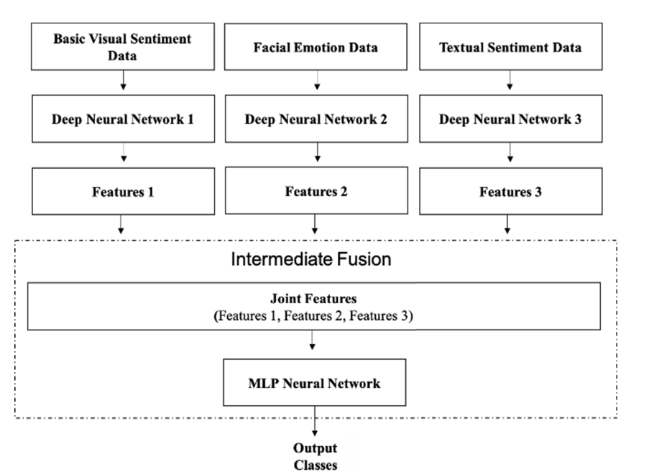
Slide 3
Proposed work
Pretrained models are fine-tuned on large-scale datasets.
Models are further refined on the newly introduced Domain-Free Multimedia Sentiment Dataset (DFMSD) to improve generalization across domains.
Images with faces.
Images with text.
Images without faces or text.
Figure 1 : The preposed architecture of vit-based multi modality fusion[1]
NATIONAL INSITUTE OF TECHNOLOGY DELHI

Slide 6
Slide 3
Literature Review
L | Paper | Year | Key Contributions/Objectives | Data Models | Model | Research Gaps
1 | "Transformer-Based Feature Fusion Approach for..." | Published in 2023 | The paper presents a novel multimodal approach... | DFMSD (Domain-Free Multimedia Sentiment Dataset) | Transformer models for ViT, NLP | Lacks coverage of online platforms
2 | Revisiting crowd behaviour analysis through deep learning... | Year: 2020 | Deep learning methods for anomaly detection... | Motion Anomaly Detection Datasets (UCSD, etc.) | Deep learning models (CNN, RNN) | Lack of structured taxonomy
3 | Beyond Sentiment Analysis: A Review of Recent Developments | Year: 2023 | Comprehensive review of recent trends in sentiment analysis | Recent Text Sentiment Analysis Models | Transition from keywords to context | Challenges in ambiguous and context-sensitive text
4 | Behavioural Analysis for Prospects in Crowd Emotion Research | Year: 2021 | Analysis of deep learning methods for crowd behavioral studies | Support Vector Machines, etc. | Machine learning and deep learning hybrid | Lack of robust datasets for diverse environments
5 | A Survey Paper on Aspect-Based Sentiment Analysis | Year: 2024 | Organization of ABSA research focusing on model scalability | ABSA Models (SVM, TD-LSTM, etc.) | CNN, RNN, BERT-based approaches | Handling negations, complex context
NATIONAL INSITUTE OF TECHNOLOGY DELHI

Slide 7
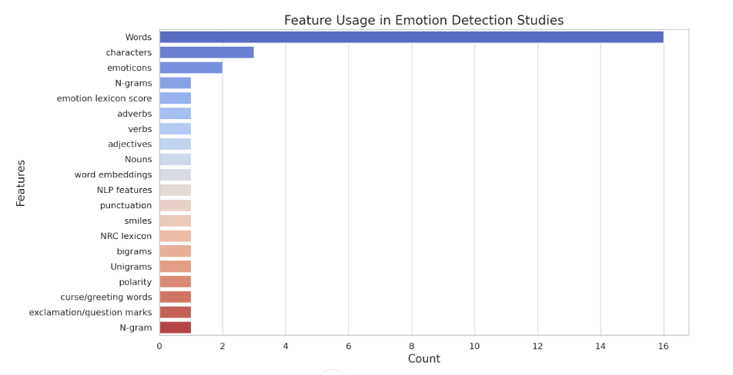
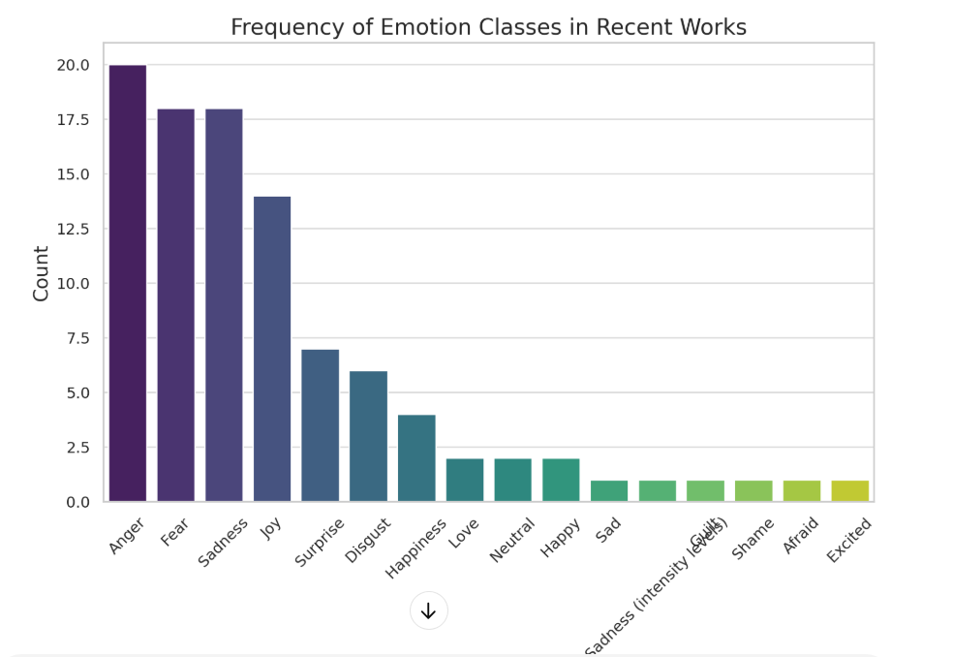
Slide 3
Literature Review
Figure 2
Figure 3
NATIONAL INSITUTE OF TECHNOLOGY DELHI

Slide 8
Slide 3
Datasets
Domain-Free Multimedia Sentiment Dataset (DFMSD):
Purpose: The newly introduced DFMSD[1] dataset is central to the proposed model's evaluation. It was designed specifically for multimodal sentiment analysis in the wild, focusing on social media data.
Content: The dataset includes tweets with associated images that fall into three categories:
Images with faces
Images with text
Images without faces or text
Size: Contains 14,488 tweets with 10,244 images.
Sentiment Labels: Sentiment labels for the tweets are categorized into three classes: positive, negative, and neutral.
Challenges Addressed: The DFMSD dataset aims to overcome the limitations of existing datasets by being domain-free, meaning it was collected without specific keywords, locations, or predefined criteria, reflecting real-world variability.
NATIONAL INSITUTE OF TECHNOLOGY DELHI

Slide 9
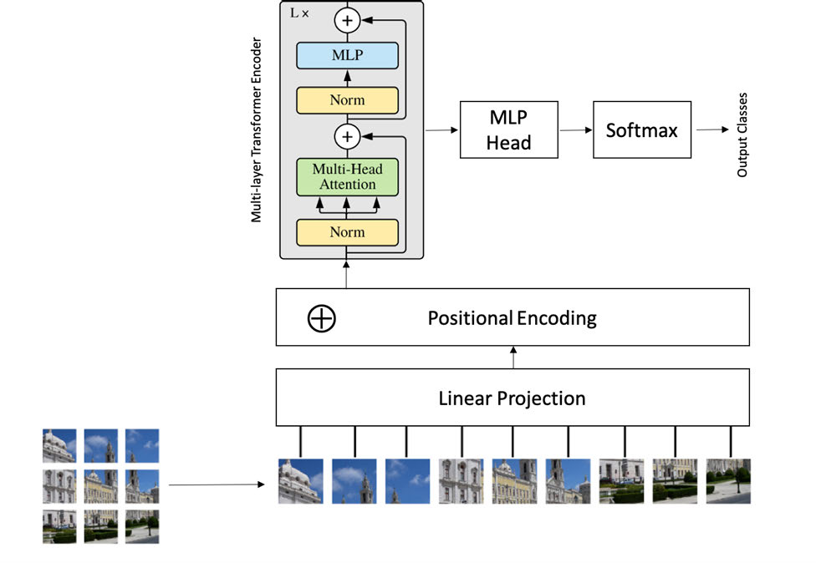
Slide 3
Methodology
Vision Transformers (ViT))
Visual transformers (Vit)[2]Images are split into patches and processed using self-attention mechanisms. This allows the model to capture global and local features.
Textual features are extracted using BERT, focusing on c
ontextual embeddings for sentiment analysis.
BERT
Figure 4 The Architecture of Visual Transformer (ViT) Used in Training Models[2]
NATIONAL INSITUTE OF TECHNOLOGY DELHI

Slide 10
Slide 3
Conclusion
Handling Data Imbalance:
The integration of the threshold-moving technique during training effectively addresses class imbalance, improving accuracy and F-scores, especially for minority classes..
Results of ViT for Sentiment Analysis[1]:
ViT Sentiment Model (First-Stage Fine-Tuning):
Dataset Used: T4SA and Affect Net
Sentiment Classes: Positive, Negative, Neutral
Performance Metrics (after first-stage fine-tuning on the DFMSD[1] dataset):
Metric | Positive Class | Negative Class | Neutral Class | Overall
Accuracy | 82% | 79% | 68% | 76%
Precision | 0.85 | 0.77 | 0.65 | -
Recall | 0.81 | 0.74 | 0.72 | -
F-Score | 0.83 | 0.75 | 0.68 | -
NATIONAL INSITUTE OF TECHNOLOGY DELHI

Slide 11
Slide 3
Reference
lzamzami, F., & El Saddik, A. (2023). Transformer-Based Feature Fusion Approach for Multimodal Visual Sentiment Recognition Using Tweets in the Wild. IEEE Access, 11, 47070–47079. https://doi.org/10.1109/ACCESS.2023.3274744
Alzamzami, F., Hoda, M., & El Saddik, A. (2020). Light gradient boosting machine for general sentiment classification on short texts: A comparative evaluation. IEEE Access, 8, 101840-101858. https://doi.org/10.1109/ACCESS.2020.2992552
Dosovitskiy, A., Beyer, L., Kolesnikov, A., Weissenborn, D., Zhai, X., Unterthiner, M., Dehghani, M., Minderer, M., Heigold, G., Gelly, S., Uszkoreit, J., & Houlsby, N. (2020). An image is worth 16×16 words: Transformers for image recognition at scale. arXiv:2010.11929. https://arxiv.org/abs/2010.11929
Meng, L., Li, H., Chen, B.-C., Lan, S., Wu, Z., Jiang, Y.-G., & Lim, S.-N. (2021). AdaViT: Adaptive vision transformers for efficient image recognition. arXiv:2111.15668. https://arxiv.org/abs/2111.15668
Alzamzami, F., & El Saddik, A. (2021). Monitoring cyber SentiHate social behavior during COVID-19 pandemic in North America. IEEE Access, 9, 91184-91208. https://doi.org/10.1109/ACCESS.2021.3066690
Devlin, J., Chang, M.-W., Lee, K., & Toutanova, K. (2018). BERT: Pre-training of deep bidirectional transformers for language understanding. arXiv:1810.04805. https://arxiv.org/abs/1810.04805
Wang, H., Tobon, V. D. P., Hossain, M. S., & El Saddik, A. (2021). Deep learning (DL)-enabled system for emotional big data. IEEE Access, 9, 116073-116082. https://doi.org/10.1109/ACCESS.2021.3066690
Miao, Y., Dong, H., Jaam, J. M. A., & Saddik, A. E. (2019). A deep learning system for recognizing facial expression in real-time. ACM Transactions on Multimedia Computing, Communications, and Applications, 15(2), 1–20. https://doi.org/10.1145/3309626
Athanasiou, V., & Maragoudakis, M. (2017). A novel, gradient boosting framework for sentiment analysis in languages where NLP resources are not plentiful: A case study for modern Greek. Algorithms, 10(1), 34. https://doi.org/10.3390/a10010034
NATIONAL INSITUTE OF TECHNOLOGY DELHI

Slide 12
Thank you
NATIONAL INSITUTE OF TECHNOLOGY DELHI

